Slide 1
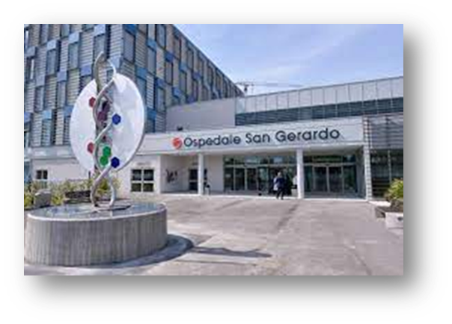
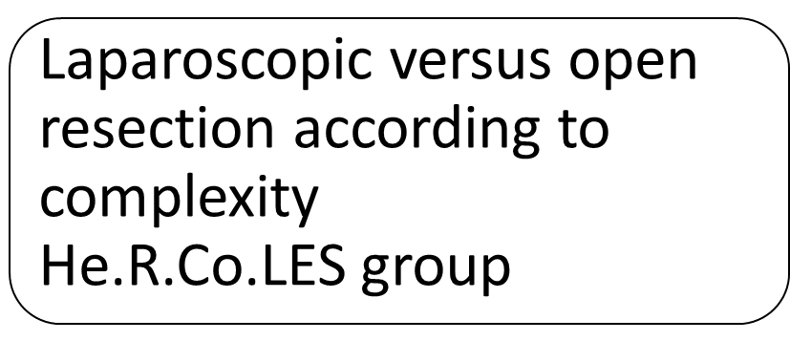
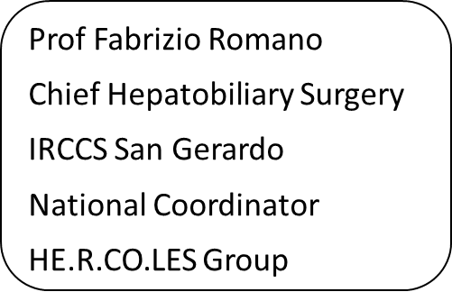




Slide 2
Introduction
Cornerstones in the development of laparoscopic liver surgery
A journey long 35 years

Slide 3
Introduction
The long journey through complexity…………
COMP
L
E
X
I
T
Y

Slide 4
Introduction
Year by year increase of laparoscopic liver procedures

Slide 5
Introduction
MALS in HCC
HCC account for approximately 30% of laparoscopic hepatectomies performed worldwide

Slide 6
Introduction
HCC is a good indication for laparoscopic approach even due to the presence of cirrhosis

Slide 7
Introduction
MALS show it’s superiority or non inferiority in HCC setting compared to OLR

Slide 8
Laparoscopic approach cover all the spectrum of liver resection for hcc
Advantage
Less blood loss
Diminished POA
Shorter LOS
Similar oncological outcomes
Left lobectomy
Postero-superior segments
elderly
huge
Major hepatectomy
Child B
complexity

Slide 9
Introduction
Robust data regarding the advantages of MALS

Slide 10
Introduction
Does MALS have an effect on long-term survival of patients with HCC?

Slide 11
introduction
MALS Is hierarchically superior to OLR because improves outcome and increase the indications

Slide 12
Introduction
Some concerns…
Most of the experience arise from retrospective studies and third-referral centers which introduce high degree of bias when compared to real-life scenario
Most of the studies made comparison regardless of the surgical complexity, avoiding a strict evaluation of MALS on different types of liver resections.

Slide 13
Introduction
So…..advantages of MALS are equal for every kind of surgery?
Regardless of indication the advantages of MALS correlate to the difficulty of resection

Slide 14
Introduction
The higher the complexity The higher the benefit of MALS

Slide 15
Introduction
The higher the burden of the tumor The higher the advantages of MALS

Slide 16
Introduction
Has been demonstrated that morbidity is related to complexity

Slide 17
introduction
The delta complication between MALS and OLR increase when complexity increase

Slide 18
Methods
The Italian HCC Surgical Register

Slide 19
methods
Multicentric national
(36 Italian Centers ) real-life study on resection for HCC
The map of Hercoles
Data collected prospectively
Centers with
Low, Medium , high
Volume of liver resection
No restriction on annually treated patients.
170 variables covering comorbidities, underlying liver function, radiological and intraoperative findings
Postoperative course, histological assesment and follow up

Slide 20
methods
To overcome the limits of literature’s studies we conduct an in-depth analysis of a national real-life multicenter cohort of patients who have undergone liver resection for HCC
The study aims to compare perioperative outcomes (overall complication, major complication, POA) of MALS and OLR, in a specific setting (HCC) with stratification according to the surgical complexity (Kawaguchi)

Slide 21
methods
All case were collected on an intention-to-treat basis without restriction according to center volume or learning curve
33.7% MALS
1596
Patients were stratified according to the complexity fo the procedure (Kawaguchi)
CP1 low
CP2 intermediate
CP3 high
4738 resezioni per HCC
66.3% Open
3142

Slide 22
methods
Patients were stratified according to the complexity of the procedure
CP1 low (wedge/left lateral sectionectomy
CP2 intermediate (AL segmentectomy/LH)
CP3 high (PS segmentectomy, RH, ERH, ELH , RPS, CH

Slide 23
methods
CP1 low 2522 (53.2%)
CP2 intermediate 974 (20.6%)
CP3 high 1242 (26.2%)

Slide 24
methods
An inverse probability weighting (IPW) was performed to ensure balanced comparisons

Slide 25
results
More of studies don’t take in account the procedure’s complexity
Multicentric studies are based on third-referral centers
Most of the studies adopt a PSM to reduce the risk of selection bias
MALS = easier procedures Matched with easier OLR = reduction of cohort complexity caused by PSM
Cohort divided according to procedure’s complexity
Real world scenarios not only referral centers, no case-load restriction
Inverse probability treatment weighting to create populations with similar characteristics
First report of a real world measurement of the outcomes after MALS vs OLR
among the largest series available in literature about HCC

Slide 26
results
CP1 MALS was associated with reduced POA and MC
CP2 MALS was associated with MC but not with POA
CP3 MALS was associated with increase MC
CP1
(Wedge + LLS)
CP2
Al segments + LH
CP3
PS segments + RH
Overall
compl
Low-volume centers had significantly higher MC after CP2 and CP3 procedures than medium and high volume centers
Major compl
POA

Slide 27
conclusions
MALS was independently associated with a reduced rate of overall complications regardless of the surgical complexity
MALS was a protective factor from POA only in case of CP1 procedures
MALS for CP3 procedures was associated with an higher risk of major complications, but having surgery in a high or medium volume center reduce this risk more than MALS itself increases it
Major
compl

Slide 28
conclusions
Peculiar results of the study
Reduction of rate of complication is well established with MALS
In our study MALS is protective factor for major complication in CP1 and CP2 groups but is a significant risk factor in CP3 in a real-world scenario (risk of conversion, prolonged ischemic time, operative time, control of bleeding).
Multicentric studies are based on third-referral centers
MALS was superior in reducing the risk of postoperative liver decompensation, such as POA, only in the low difficult group CP1 (reduce need for mobilization and lymphadenectomy and major trend in performing wedge resection) and not in CP2 and CP3 (other factor become more relevant such as underlying liver disease, tumor characteristics..)

Slide 29
conclusions
MALS is currently the preferred approach to patients who need surgery for HCC with proven better results compared to open surgery
The study offer a comprehensive perspective on the impact of MALS in treating HCC
The findings underscore the limitation of MALS in most complex resections, which need skilled center with high volumes

Slide 30
For more informations:
Prof Fabrizio Romano
fabrizio.romano@unimib.it
www.hercolesgroup.eu

